Slide 1
Logistic Regression

Slide 2
Outline
Review of simple and multiple regression
Simple Logistic Regression
  The logistic function
  Interpretation of coefficients
    continuous predictor (X)
    dichotomous categorical predictor (X)
    categorical predictor with three or more levels (X)
Multiple Logistic Regression
Examples

Slide 3
Simple Linear Regression
Model the mean of a numeric response Y as a function of a single predictor X, i.e.
E(Y|X) = β_{o} + β₁f(x)
Here f(x) is any function of X, e.g.
f(x) = X ➔ E(Y|X) = β_{o} + β₁X (line)
f(x) = ln(X) ➔ E(Y|X) = β_{o} + β₁ln(X) (curved)
The key is that E(Y|X) is a linear in the
parameters β_{o} and β₁ but not necessarily in X.

Slide 4



Simple Linear Regression
^
β₀ = Estimated Intercept
= -value at x = 0
^
Interpretable only if x = 0 is a
value of particular interest.
β₁ w units
^
β₀
^
w units
β₁ = Estimated Slope
= Change in for every
unit increase in x
0
x
= estimated change in the mean of Y for a unit change in X.
Always interpretable!

Slide 5
Multiple Linear Regression
We model the mean of a numeric response as linear combination of the predictors themselves or some functions based on the predictors, i.e.
E(Y|X) = β_{o} + β₁X₁+ β₂X₂ +…+ β_{p}X_{p}
Here the terms in the model are the predictors
E(Y|X) = β_{o} + β₁ f₁(X)+ β₂ f₂(X)+…+ β_{k} f_{k}(X)
Here the terms in the model are k different functions of the p predictors

Slide 6
Multiple Linear Regression
For the classic multiple regression model
E(Y|X) = β_{o} + β₁X₁+ β₂X₂ +…+ β_{p}X_{p}
the regression coefficients (β_{i}) represent the estimated change in the mean of the response Y associated with a unit change in X_{i} while the other predictors are held constant.
They measure the association between Y and X_{i} adjusted for the other predictors in the model.

Slide 7
General Linear Models
Family of regression models
Response Model Type
  Continuous Linear regression
  Counts Poisson regression
  Survival times Cox model
  Binomial Logistic regression
Uses
  Control for potentially confounding factors
  Model building , risk prediction

Slide 8
Logistic Regression
Models relationship between set of variables X_{i}
  dichotomous (yes/no, smoker/nonsmoker,…)
  categorical (social class, race, ... )
  continuous (age, weight, gestational age, ...)
and
  dichotomous categorical response variable Y
  e.g. Success/Failure, Remission/No Remission Survived/Died, CHD/No CHD, Low Birth Weight/Normal Birth Weight, etc…

Slide 9
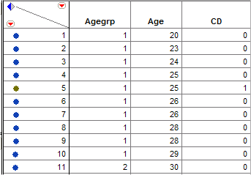
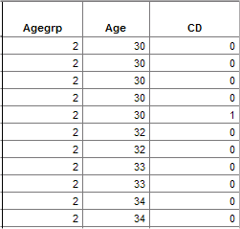

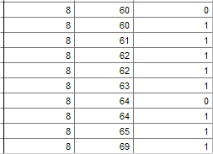
Logistic Regression
Example: Coronary Heart Disease (CD) and Age In this study sampled individuals were examined for signs of CD (present = 1 / absent = 0) and the potential relationship between this outcome and their age (yrs.) was considered.
…
This is a portion of the raw data for the 100 subjects who participated in the study.

Slide 10
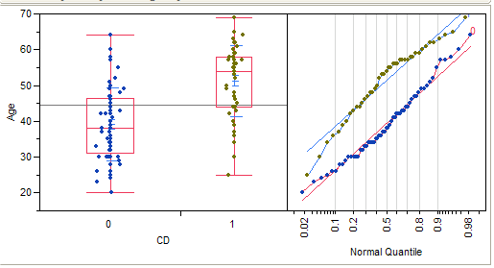
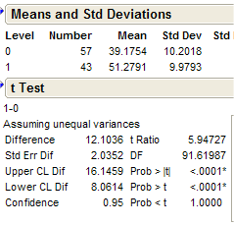
Logistic Regression
How can we analyze these data?
Non-pooled t-test
The mean age of the individuals with some signs of coronary heart disease is 51.28 years vs. 39.18 years for individuals without signs (t = 5.95, p < .0001).

Slide 11
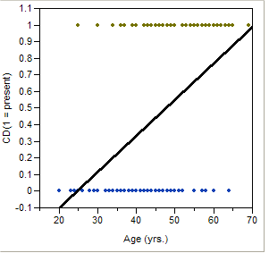
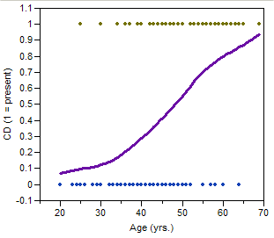
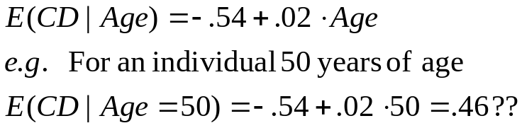
Logistic Regression
Simple Linear Regression? Smooth Regression Estimate?
The smooth regression estimate is “S-shaped” but what does the estimated mean value represent?
Answer: P(CD|Age)!!!!

Slide 12
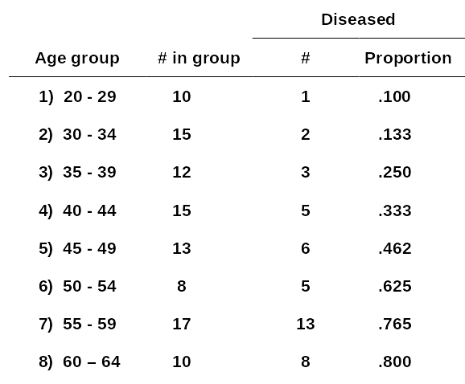
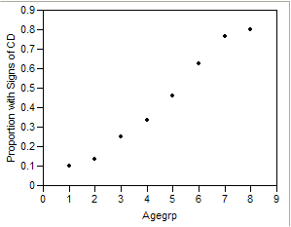
Logistic Regression
We can group individuals into age classes and look at the percentage/proportion showing signs of coronary heart disease.
Notice the “S-shape” to the estimated proportions vs. age.

Slide 13
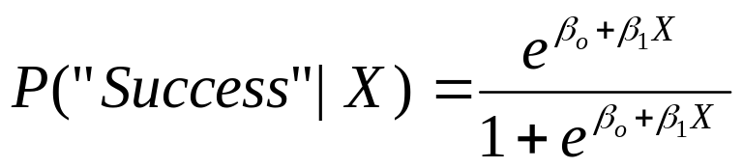
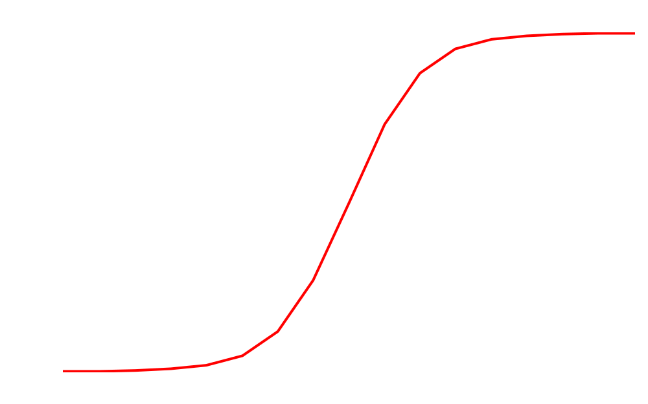
Logistic Function
P(“Success”|X)
X

Slide 14
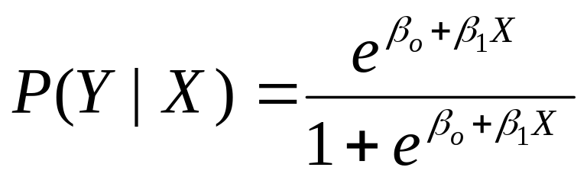
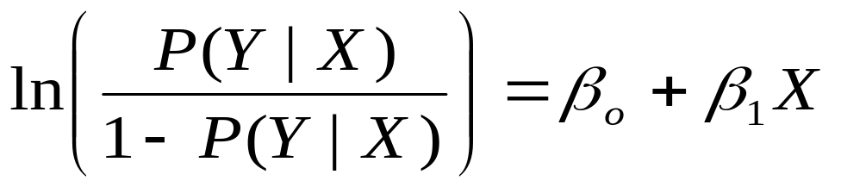
Logit Transformation
The logistic regression model is given by
which is equivalent to
This is called the
Logit Transformation

Slide 15
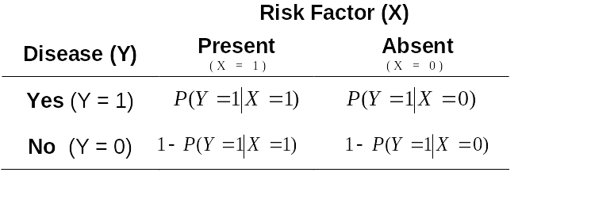
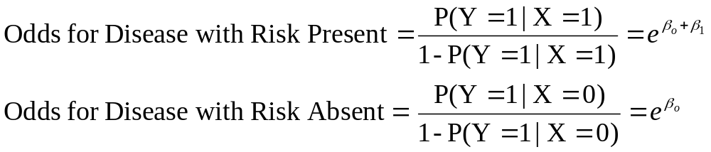
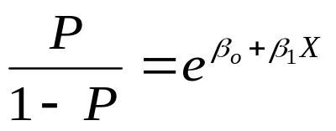
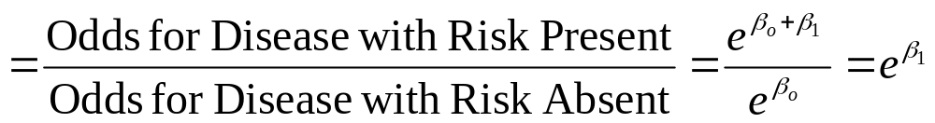
Dichotomous Predictor
Consider a dichotomous predictor (X) which represents the presence of risk (1 = present)
Therefore the odds ratio (OR)

Slide 16
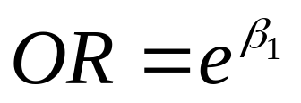
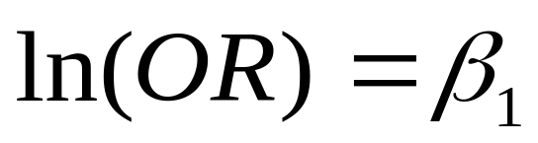
Dichotomous Predictor
Therefore, for the odds ratio associated with risk presence we have
Taking the natural logarithm we have
thus the estimated regression coefficient associated with a 0-1 coded dichotomous predictor is the natural log of the OR associated with risk presence!!!

Slide 17
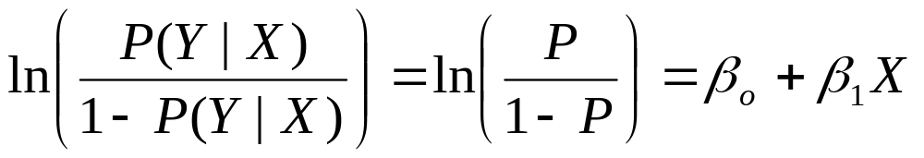
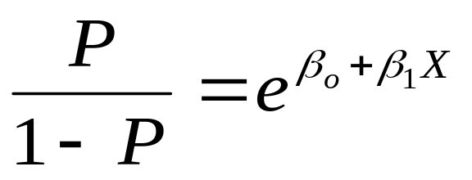
Logit is Directly Related to Odds
The logistic model can be written
This implies that the odds for success can be expressed as
This relationship is the key to interpreting the coefficients in a logistic regression model !!

Slide 18
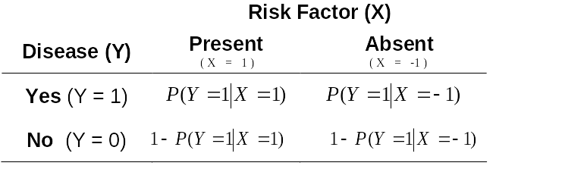
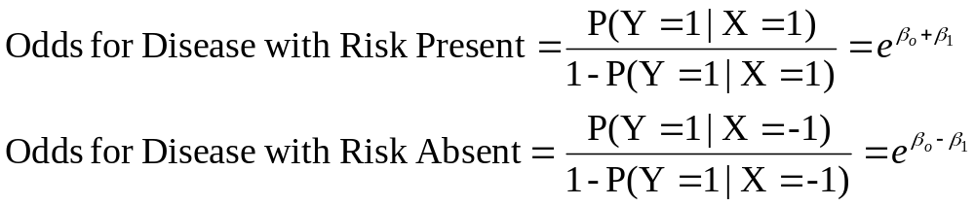
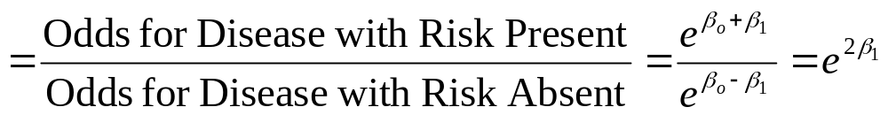
Dichotomous Predictor (+1/-1 coding)
Consider a dichotomous predictor (X) which represents the presence of risk (1 = present)
Therefore the odds ratio (OR)

Slide 19
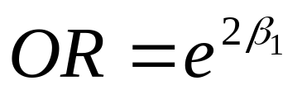
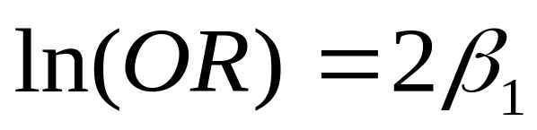
Dichotomous Predictor
Therefore, for the odds ratio associated with risk presence we have
Taking the natural logarithm we have
thus twice the estimated regression coefficient associated with a +1 / -1 coded dichotomous predictor is the natural log of the OR associated with risk presence!!!

Slide 20
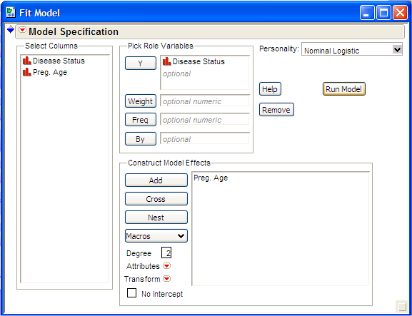
Example: Age at 1st Pregnancy and Cervical Cancer
Use Fit Model Y = Disease Status
X = Risk Factor Status
When the response Y is a dichotomous categorical variable the Personality box will automatically change to Nominal Logistic, i.e. Logistic Regression will be used.
Remember when a dichotomous categorical predictor is used JMP uses +1/-1 coding. If you want you can code them as 0-1 and treat is as numeric.

Slide 21

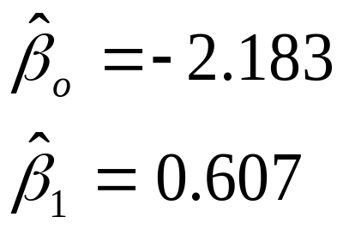
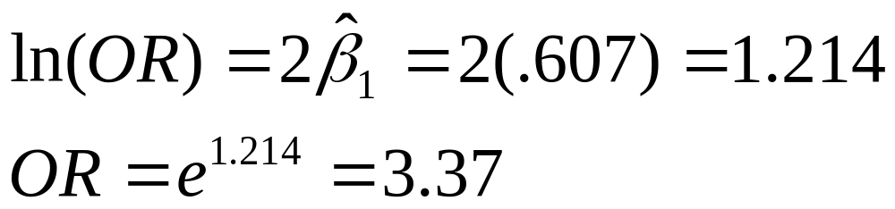
Example: Age at 1st Pregnancy and Cervical Cancer
Thus the estimated odds ratio is
Women whose first pregnancy is at or before age 25 have 3.37 times the odds for developing cervical cancer than women whose 1st pregnancy occurs after age 25.

Slide 22
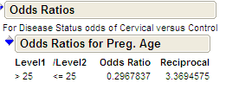
Example: Age at 1st Pregnancy and Cervical Cancer
Thus the estimated odds ratio is
Risk Present
Odds Ratio for disease associated with risk presence

Slide 23

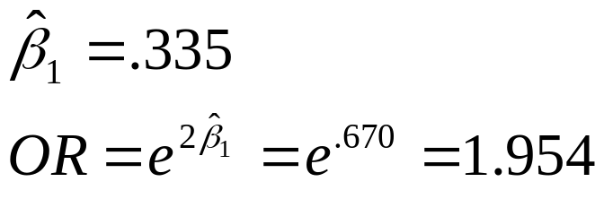

Example: Smoking and Low Birth Weight
Use Fit Model Y = Low Birth Weight (Low, Norm)
X = Smoking Status (Cig, NoCig)
We estimate that women who smoker during pregnancy have 1.95 times higher odds for having a child with low birth weight than women who do not smoke cigarettes during pregnancy.

Slide 24
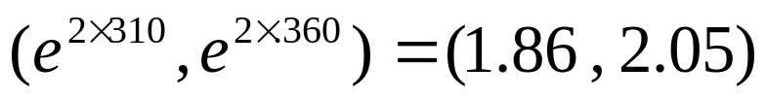
Example: Smoking and Low Birth Weight
Find a 95% CI for OR
1st Find a 95% CI for β₁
2nd Compute CI for OR = (e^{2LCL}, e^{2UCL})
(LCL,UCL)
We estimate that the odds for having a low birth weight infant are between 1.86 and 2.05 times higher for smokers than non-smokers, with 95% confidence.

Slide 25
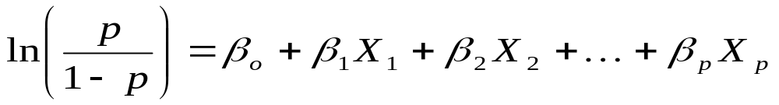
Example: Smoking and Low Birth Weight
We might want to adjust for other potential confounding factors in our analysis of the risk associated with smoking during pregnancy. This is accomplished by simply adding these covariates to our model.
Multiple Logistic Regression Model
Before looking at some multiple logistic regression examples we need to look at how continuous predictors and categorical variables with 3 or levels are handled in these models and how associated OR’s are calculated.

Slide 26
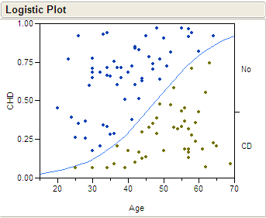

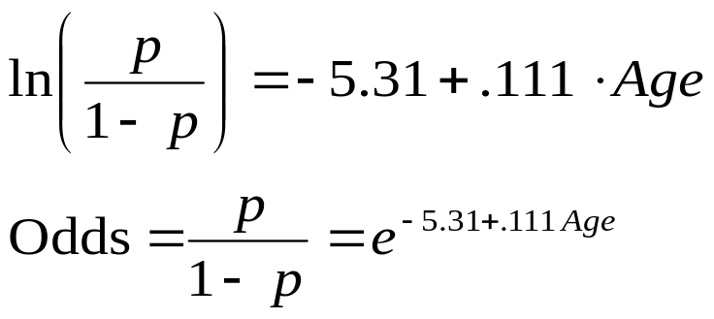
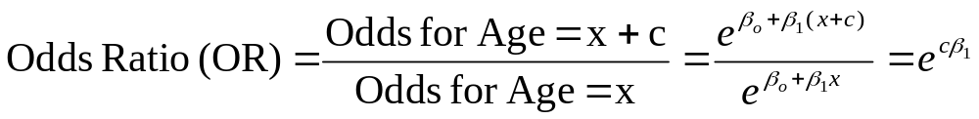
Example 2: Signs of CD and Age
Fit Model Y = CD (CD if signs present, No otherwise)
X = Age (years)
Consider the risk associated with a c year increase in age.

Slide 27
Example 2: Signs of CD and Age
For example consider a 10 year increase in age, find the associated OR for showing signs of CD, i.e. c = 10
OR = e^{cβ} = e^{10*.111} = 3.03
Thus we estimate that the odds for exhibiting signs of CD increase threefold for each 10 years of age. Similar calculations could be done for other increments as well.
For example for a c = 1 year increase
OR = e^{β} = e^{.111} = 1.18 or an 18% increase in odds per year

Slide 28
Example 2: Signs of CD and Age
Can we assume that the increase in risk associated with a c unit increase is constant throughout one’s life?
Is the increase going from 20 → 30 years of age the same as going from 50 → 60 years?
If that assumption is not reasonable then one must be careful when discussing risk associated with a continuous predictor.

Slide 29
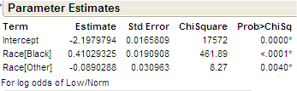
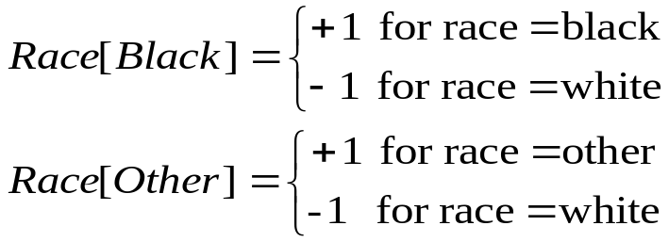
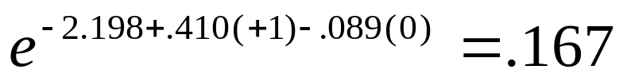

Example 3: Race and Low Birth Weight
Calculate the odds for low birth weight for each race (Low, Norm)
White Infants (reference group, missing in parameters)
Black Infants
Other Infants
OR for Blacks vs. Whites
= .167/.0805 = 2.075
OR for Others vs. Whites
= .102/.0805 = 1.267
OR for Black vs. Others
= .167/.102 = 1.637

Slide 30
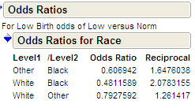
Example 3: Race and Low Birth Weight
Finding these directly using the estimated parameters is cumbersome. JMP will compute the Odds Ratio for each possible comparison and their reciprocals in case those are of interest as well.
Odds Ratio column is odds for Low for Level 1 vs. Level 2.
Reciprocal is odds for Low for Level 2 vs. Level 1. These are the easiest to interpret here as they represent increased risk.

Slide 31
Putting it all together
Now that we have seen how to interpret each of the variable types in a logistic model we can consider multiple logistic regression models with all these variable types included in the model.
We can then look at risk associated with certain factors adjusted for the other covariates included in the model.

Slide 32
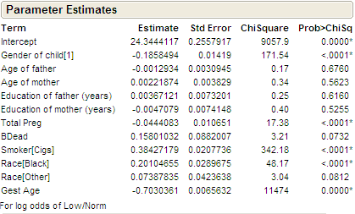
Example 3: Smoking and Low Birth Weight
Consider again the risk associated with smoking but this time adjusting for the potential confounding effects of education level and age of the mother & father, race of the child, total number of prior pregnancies, number children born alive that are now dead, and gestational age of the infant.
Several terms are not statistically significant and could consider using backwards elimination to simplify the model.

Slide 33
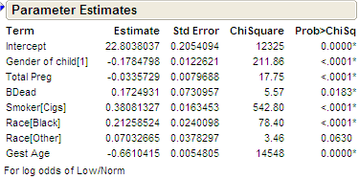

Example 3: Race and Low Birth Weight
None of the mother and farther related covariates entered into the final model.
Adjusting for the included covariates we find smoking is statistically significant (p < .0001)
Adjusting for the included covariates we find the odds ratio for low birth weight associated with smoking during pregnancy is 2.142.
Odds Ratios for the other factors in the model can be computed as well. All of which can be prefaced by the “adjusting for…” statement.

Slide 34
Summary
In logistic regression the response (Y) is a dichotomous categorical variable.
The parameter estimates give the odds ratio associated the variables in the model.
These odds ratios are adjusted for the other variables in the model.
One can also calculate P(Y|X) if that is of interest, e.g. given demographics of the mother what is the estimated probability of her having a child with low birth weight.

